Slide 1
HPML Final Project · Spring 2026
Multi-Modal Agent Inference Optimization for Industrial Asset Operations
We extended AssetOpsBench with a multi-modal Visual Inspection Agent and applied AWQ W4A16 quantization, achieving a 2.47× E2E speedup on Llama and 1.98× on Qwen with domain calibration on a single NVIDIA L4 GPU.
Columbia HPML Team 23
Amaan Sheikh · aas2438
Aman Upganlawar · au2327
Madhav Rajkondawar · mr4650
Yang-Jung Chen · yc4670
GitHub: https://github.com/amaan784/hpml-final-project
Tracking: https://wandb.ai/amaan784-columbia-university/hpml-final-benchmark
Dr. Kaoutar El Maghraoui · Columbia University · Week of May 4, 2026
Notes:
Eric

Slide 2
Motivation & Problem
Why this matters
Problem statement
AssetOpsBench (AAAI 2026) covers 141 industrial AI scenarios across text and time series, but has no vision component, despite many failure modes (corrosion, ice buildup, bearing damage) appearing visually before sensor data flags them.
Serving large VLMs at FP16 is expensive: a limited KV cache pool constraints throughput for multi-agent industrial workloads.
Off-the-shelf quantization (generic calibration) introduces a runaway-generation failure mode. ALso, Naive INT4 is not reliable enough for industrial deployment.
Can we add a vision modality to AssetOpsBench via a VLM-powered MCP agent and optimize its inference (AWQ quantization, calibration regime) on a single NVIDIA L4 GPU without sacrificing reliability?
Goal: ≥2× E2E speedup with domain-calibrated AWQ INT4 on a single L4 GPU, at maintained reliability.
HPML · Spring 2026
Notes:
Eric

Slide 3
Technical Approach: Model & Data
Model
Dataset
Hardware
Primary: Qwen2.5-VL-7B-Instruct (7B params, VLM, vLLM 0.19 serving)
Baseline: Llama-3-LLaVA-NeXT-8B (8B params, Llama-3 backbone + LLaVA-NeXT vision tower)
Orchestration: In-process ReAct agent and Plan-execute via MCP stdio subprocess
4 public industrial datasets (~10,800 images total):
Kaggle Casting Product (pumps, 7,348 images)
Mendeley Thermal Induction Motor (~488 thermal images, 11 fault classes)
HuggingFace 15-class Substation Equipment (1,660 RGB photos, YOLO-annotated)
Blade30 Wind Turbine Blades (1,302 drone images, defect annotations)
GCP g2-standard-8, 1× NVIDIA L4 GPU (24 GB VRAM) vLLM 0.19.0, PyTorch, llmcompressor 0.10.0.2, transformers 4.57
HPML · Spring 2026
Notes:
Eric

Slide 4
Technical Approach: Optimizations Applied
1.
AWQ W4A16 Quantization with Domain Calibration (L1d)
INT4 weight quantization calibrated on 128 domain-specific industrial-inspection prompts: 1.98x Qwen L1d speedup, 4.7× KV cache capacity
2.
AWQ W4A16 Quantization with Generic Calibration (L1g)
Same INT4 quantization but calibrated on generic ultrachat_200k samples: 2.55× median speedup (p50)
3.
Visual Inspection MCP Agent + vLLM Serving
VLM served via vLLM with MCP stdio interface; exposes vision.analyze_image, vision.assess_condition, and vision.detect_visual_defects tools conforming to the AssetOpsBench agent contract.
HPML · Spring 2026

Slide 5
Profiling Methodology
Tools
Metrics captured
PyTorch Profiler / torch.profiler
vLLM Prometheus metrics endpoint
Weights & Biases for run-level tracking
Latency (p50, p95) and throughput
GPU utilization & SM occupancy
Peak GPU memory and HBM bandwidth
Time per stage: data → fwd → bwd → opt
Task quality metric: accuracy and LLM-as-judge mean score
HPML · Spring 2026

Slide 6
Results: Headline Numbers
2.05×
87.5%
2.99×
E2E speedup (Qwen L1d)
accuracy with domain AWQ
Mean speedup (L1g p50)
8,211 ms → 3,995 ms mean E2E
15.54 GiB → 5.9 VRAM (2.6× reduction)
Llama: 9,384 ms down to 3,136 ms mean E2E
All measurements on GCP g2-standard-8 with NVIDIA L4 (24 GB VRAM). 22 scenarios per variant, 10 variants total.
HPML · Spring 2026

Slide 7
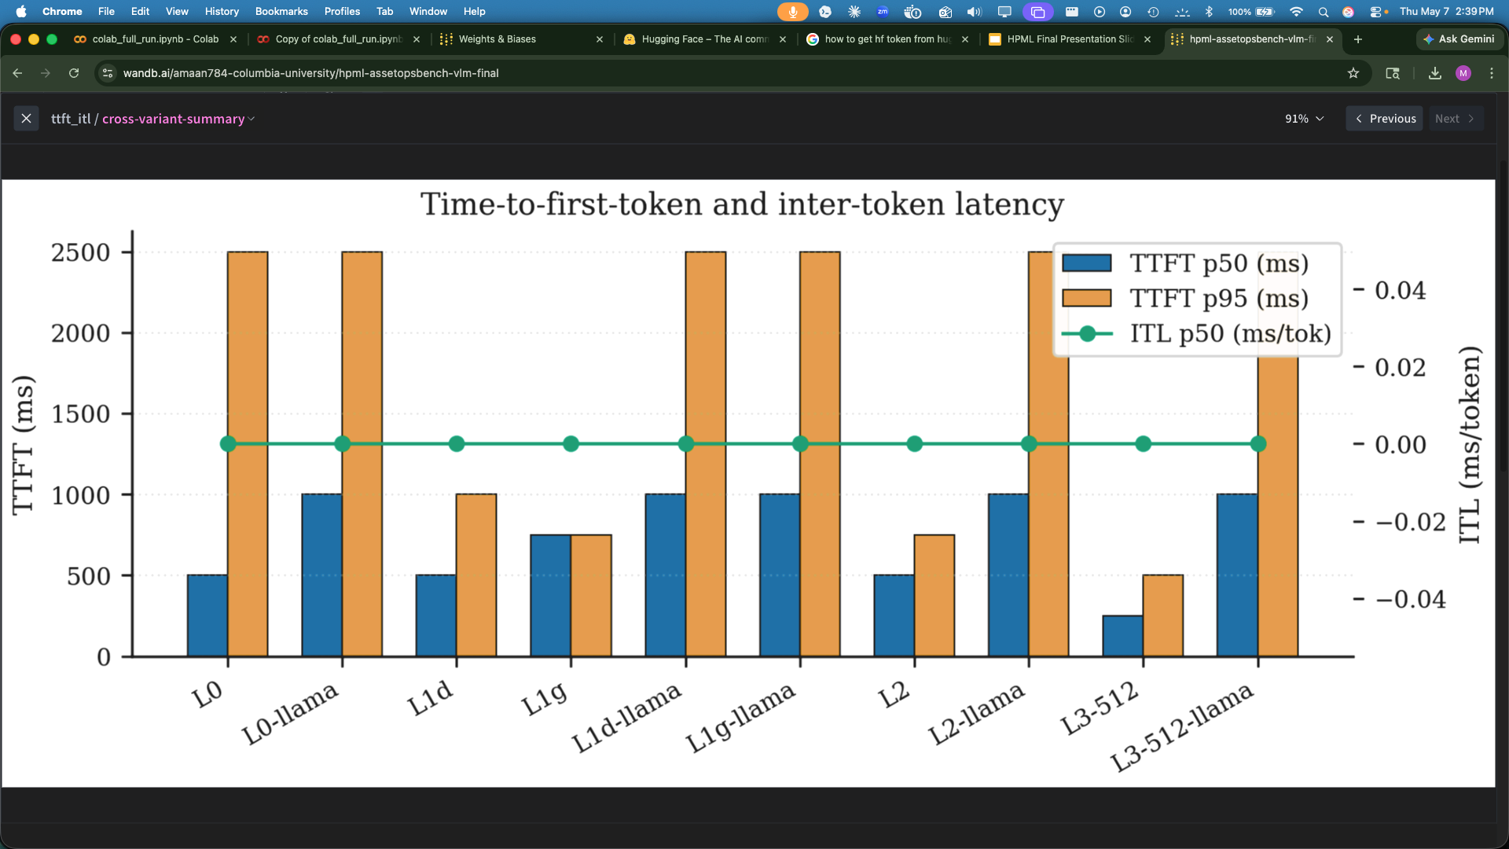
Results: Before and After
Takeaway
Domain-calibrated AWQ (L1d) on Qwen nearly halved latency to 4,712 ms mean while accuracy improved from 68.8% to 87.5%.
L1d (domain AWQ) contributed most: 2.05× speedup
The L2 full bundle hit 1,157 ms p50 (fastest of all variants) but accuracy collapsed to 0% on Qwen, showing that aggressive serving tuning can break generation quality.
HPML · Spring 2026
Notes:
Madhav

Slide 8
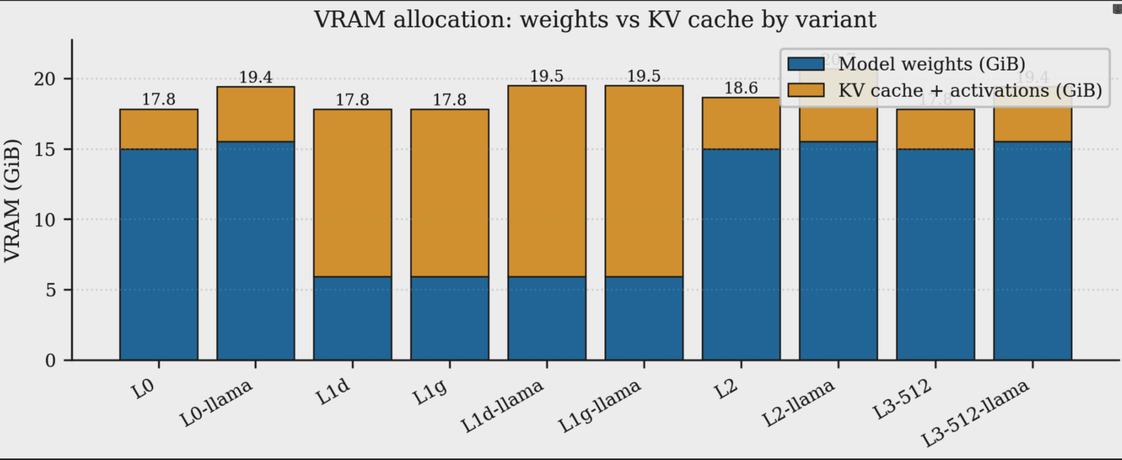
Profiler Evidence
What to point at
At FP16, Qwen occupied 17.8 GiB total with very little headroom left for the KV cache pool.
AWQ INT4 packing on Llama dropped weight footprint from 15.54 GiB to 5.9 GiB, freeing 9.6 GiB for the KV cache.
KV cache pool grew from 2.59 GiB → 12.23 GiB (4.7×): 21K → 100K concurrent tokens.
Generic calibration produced one runaway request at 121.8 s that inflated the Llama L1g mean from 3,063 ms (p50) to 7,814 ms, a clear reliability failure absent from domain calibration.
HPML · Spring 2026
Notes:
Madhav

Slide 9
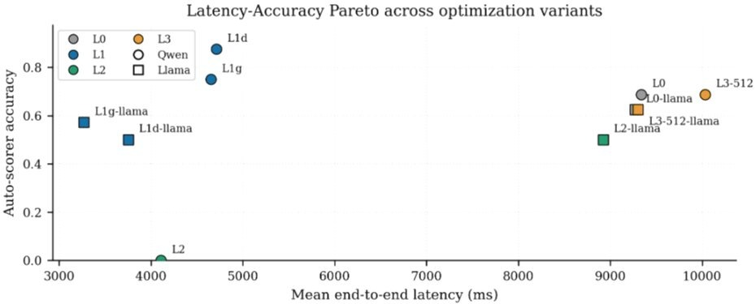
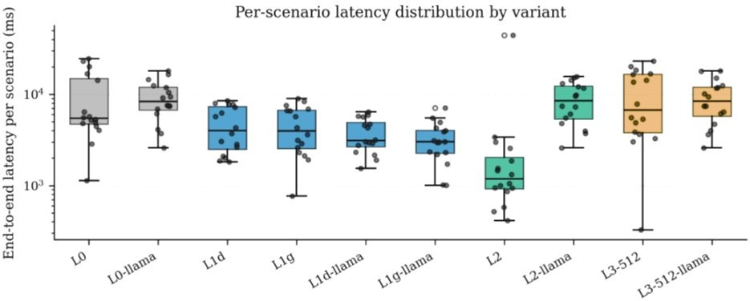
Results: Latency-Accuracy Tradeoff
Key takeaways
Qwen L1d (domain AWQ) is the optimal variant: 1.98x mean speedup with accuracy improving from 68.8% to 87.5%.
Llama L1g achieves the fastest latency at 3,270 ms mean but accuracy is 57.1%
L2 on Qwen is the fastest p50 (1,314 ms) but accuracy collapsed to 0%, confirming aggressive serving tuning breaks visual generation.
L3-512 (lower image resolution) shows no latency benefit and no accuracy gain over FP16 baseline.
HPML · Spring 2026
Notes:
Madhav

Slide 10
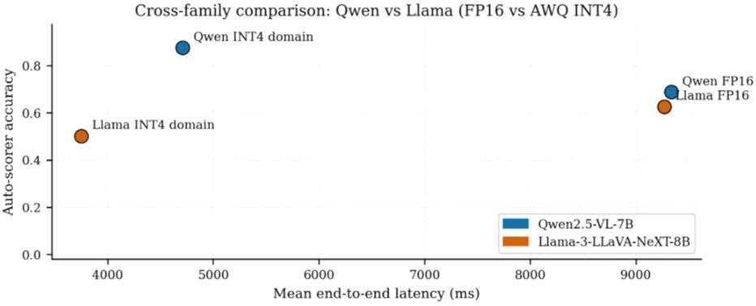
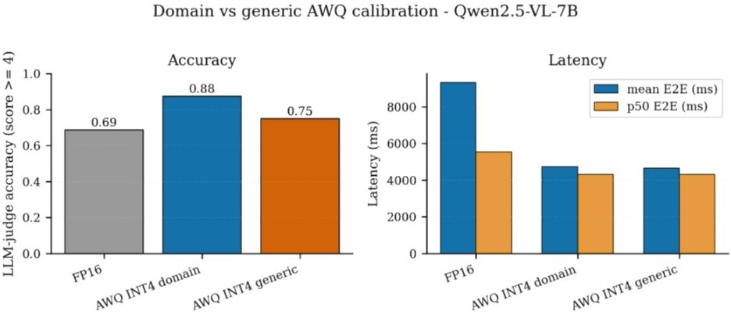
Results: Cross-Family and Calibration Comparison
Key takeaways
Qwen INT4 domain is more accurate than Llama INT4 domain on both axes: Llama is faster (4,752 vs 3,736 ms mean) and Qwen is more accurate (87.5% vs 50%).
Domain calibration beats generic on accuracy for both model families. Generic is marginally faster but unreliable.
For Qwen: domain AWQ raised accuracy from 68.8% (FP16) to 87.5%. Generic AWQ gave 75% accuracy at similar speed.
Calibration data distribution matters as much as the quantization scheme itself.
HPML · Spring 2026
Notes:
Madhav

Slide 11
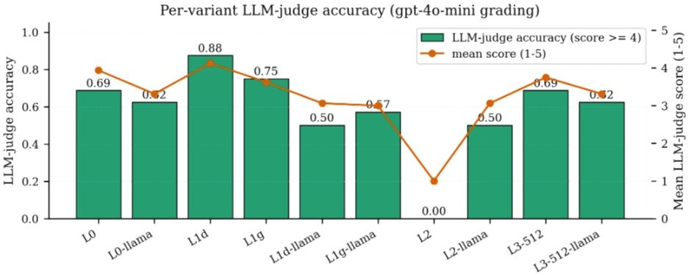
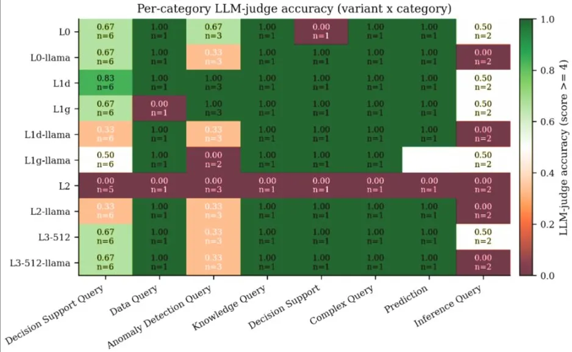
Results: Accuracy by Variant and Category
Key takeaways
L1d (Qwen domain AWQ) scores highest at 88% LLM-judge accuracy with mean score 4.1 out of 5.
L2 (Qwen full bundle) scores 0% across all categories, confirming serving tuning completely broke generation quality.
Decision Support and Anomaly Detection queries are the hardest categories, especially under Llama.
Data Query and Knowledge Query are consistently easy across all variants, suggesting the VLM handles factual lookups well regardless of quantization.

Slide 12
Lessons Learned
What worked
What didn't work
Domain-calibrated AWQ delivers reliable 2.05× speedup; calibration data distribution matters as much as quantization scheme.
Serving the VLM in dual-purpose mode (planner and vision tool) on one L4 eliminated the WatsonX API dependency entirely.
The AssetOpsBench JSON scenario schema extended cleanly to vision. Adding a Vision type required no upstream code changes.
Generic AWQ calibration (L1g) appeared faster at p50 but triggered runaway generation in 1 of 22 scenarios, hitting 121.8 s. Not safe for industrial deployment.
Llama-3.2-Vision-11B required 22 GB at FP16, leaving no headroom on the 24 GB L4. We substituted Llama-3-LLaVA-NeXT-8B at roughly 16 GB instead.
llmcompressor 0.3.0 produced fake-quant FP16 output rather than real INT4 weights. Upgrading to 0.10.0.2 with save_compressed=True was required to get actual INT4 packing.
HPML · Spring 2026

Slide 13
Next Steps
Submit the PR to the upstream IBM/AssetOpsBench repo and register the Visual Inspection Agent in AgentHive so it gets dispatched through the standard MetaAgent orchestrator.
Try running benchmarks for scenarios on GPUs with more memory (A100) to fit bigger models with higher precisions to enhance benchmarking insight.
Supervised Fine-Tuning (SFT) using LoRA or QLoRA techniques and benchmarking runs for various quantization levels for accuracy, speedup, cpu/gpu utilization, etc.
HPML · Spring 2026

Slide 14
Experimental Setup
Setting | Baseline | Optimized
Batch size | 1 (single image per request) | 1 (unchanged)
Precision | FP16 (weights + activations) | INT4 weights (AWQ W4A16), FP16 activations
Learning rate | N/A (inference only) | N/A (inference only)
Sequence length | Variable (image-dependent) | Variable (same)
Epochs / steps | 16 scenarios per variant, 10 variants | 16 scenarios per variant, 10 variants
Hardware | 1× NVIDIA L4 24 GB | 1× NVIDIA L4 24 GB
Software stack | vLLM 0.19.0, PyTorch, transformers 4.57 | llmcompressor 0.10.0.2, compressed-tensors
HPML · Spring 2026

Slide 15
Teamwork & Contributions
Member | Primary contributions | Tools / artifacts
Amaan Sheikh (aas2438) | Qwen benchmarking and quantization, pump scenarios/data, ReAct agent, LiteLLM backend, VLM benchmark flow, LLM judge replacement, sweep automation (overnight run), plots/metrics cleanup, README, vision MCP server tests | benchmark/run_vlm_benchmark.py, benchmark/llm_judge.py, benchmark/calibration.py, benchmark/hpml_metrics.py, benchmark/plots.py, benchmark/concurrent_load.py, benchmark/wandb_logger.py, benchmark/variants/L0_baseline.py, L1_awq_*, L2_*, scripts/autoawq_quantize.py, scripts/quantize_awq_domain.py, scripts/quantize_w8a8_domain.py, scripts/quantize_qwen_v010.py, scripts/serve_vllm.sh, scripts/run_full_bench.sh, scripts/overnight.sh, scripts/clean_results.py, src/agent/react/*, src/llm/litellm.py, src/servers/vision/main.py, src/servers/vision/tests/test_tools.py, src/scenarios/local/vision_pump_scenarios.json, data/pumps/*,
Aman Upganlawar (au2327) | Llama helper quant scripts, Terraform infra body, transformer scenarios/data, dataset/image loading, VLM client, Terraform validation, monitoring/NFR tooling, agent benchmark/comparison tools, health endpoint, vision test fixtures, Qwen AWQ INT4 generic calibration | terraform folder files, scripts/validate_terraform.sh, scripts/recover_save.py, scripts/repack_int4.py, scripts/quantize_awq_llama_vision_generic.py, benchmark/run_agent_benchmark.py, benchmark/compare_agents.py, benchmark/nfr_collector.py, benchmark/variants/base.py, benchmark/variants/L3_llama_image_512.py, src/servers/vision/image_loader.py, src/servers/vision/vlm_client.py, src/servers/vision/tests/conftest.py, src/scenarios/local/vision_transformer_scenarios.json, data/transformer/*
HPML · Spring 2026

Slide 16
Teamwork & Contributions
Member | Primary contributions | Tools / artifacts
Madhav Rajkondawar (mr4650) | Qwen2.5 VL 7B optimization track (L1d AWQ and L3 image preprocessing at 512 px), generic AWQ/checkpoint verification,, Project config and lockfile, motor scenarios/data, variant registry, variant tests, serve-and-benchmark wrapper ReAct retry loop, image-size variants, CUDA/VRAM profiling, WandB summary, variant pruning, Plan-Execute agent | pyproject.toml, uv.lock, benchmark/variants/__init__.py, benchmark/variants/__main__.py, benchmark/variants/base.py, benchmark/tests/*, benchmark/variants/L3_image_512.py, L3_image_768.py, L3_image_1024.py, L3_image_1536.py, benchmark/profile_vision_encoder.py, benchmark/wandb_summary.py, scripts/quantize_awq_generic.py, scripts/verify_checkpoint.py, scripts/serve_vllm.sh, scripts/serve_and_bench.sh, src/agent/react/runner.py, src/agent/plan_execute/*, src/scenarios/local/vision_utterance_motor.json, data/motors/*
Yang-Jung Chen (yc4670) | Llama-3-LLaVA-NeXT-8B optimization track, Llama variants, Llama quantization pipeline, Terraform , turbine scenarios/data, vLLM backend, IAP helper, early auto-scorer module, profiling, cost/dataset stats, VM and cloud setup | terraform folder files, src/llm/base.py, src/llm/vllm.py, scripts/iap_tunnel.sh, scripts/serve_and_bench.sh, scripts/setup_vm.sh, scripts/dataset_stats.py, scripts/cost_estimate.py, scripts/quantize_llmcompressor_v010.py, scripts/quantize_awq_llama_vision.py, auto_scorer.py, benchmark/profile_single.py, benchmark/profile_vision_encoder.py, benchmark/model_comparison.py, benchmark/nfr_collector.py, benchmark/variants/L0_llama_baseline.py, L1_llama_*, L2_llama_*, src/scenarios/local/vision_turbine_scenarios.json, data/turbine/*
HPML · Spring 2026

Slide 17
Thank you
Questions?
GitHub: https://github.com/amaan784/hpml-final-project
Tracking: https://wandb.ai/amaan784-columbia-university/hpml-final-benchmark?nw=nwuseramanupg
HPML · Spring 2026

